Slide 1


Introduction to Azure Kubernetes Service (AKS)
Daniel Scott-Raynsford
Microsoft MVP (CDM)
@dscottraynsford

Slide 2
Agenda
Containers: A Timeline
What is Kubernetes?
Part of Kubernetes
Azure Kubernetes Service Features
Important Notes
Kubernetes Helm
Demo

Slide 3
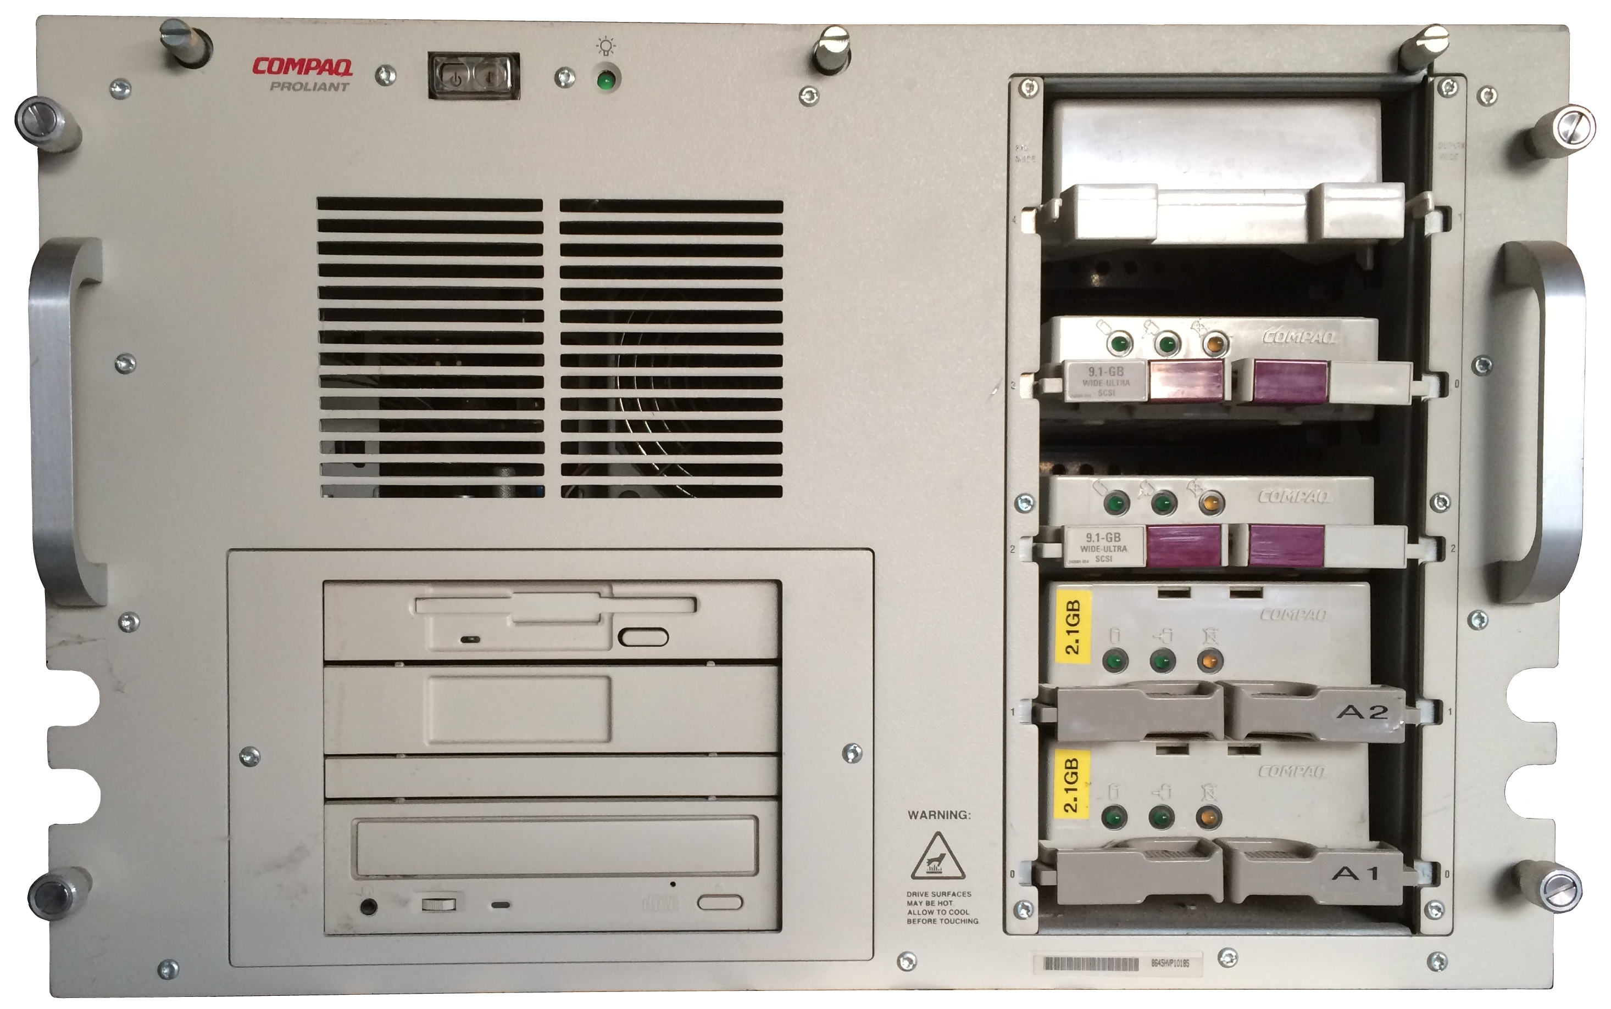
1997
Unit of Deployment
Physical Machine

Slide 4
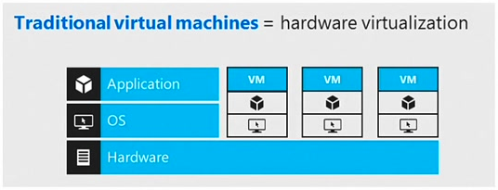
1999
Unit of Deployment
Virtual Machine

Slide 5
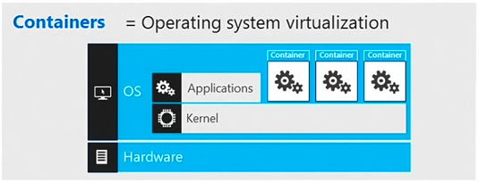

2014
Unit of Deployment
Container

Slide 6

2014
Without Orchestration

Slide 7

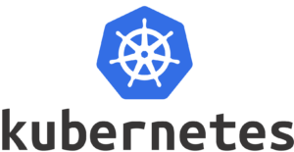
2014+
With Orchestration

Slide 8

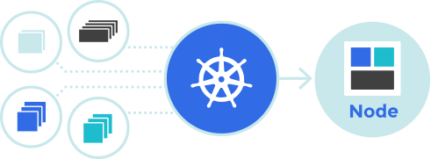
What is Kubernetes?
Developed by Google
Free, Open-Source
Runs Anywhere
On-premises, Azure (AKS, ACS), Hybrid
Other Orchestrators
DC/OS (Mesos), Swarm (Docker), Cattle (Rancher) and others

Slide 9

What Does Kubernetes Do?
Schedules Containers
Manages
State
Container Networking & Load Balancing
DNS
Persistent Storage
Secrets

Slide 10
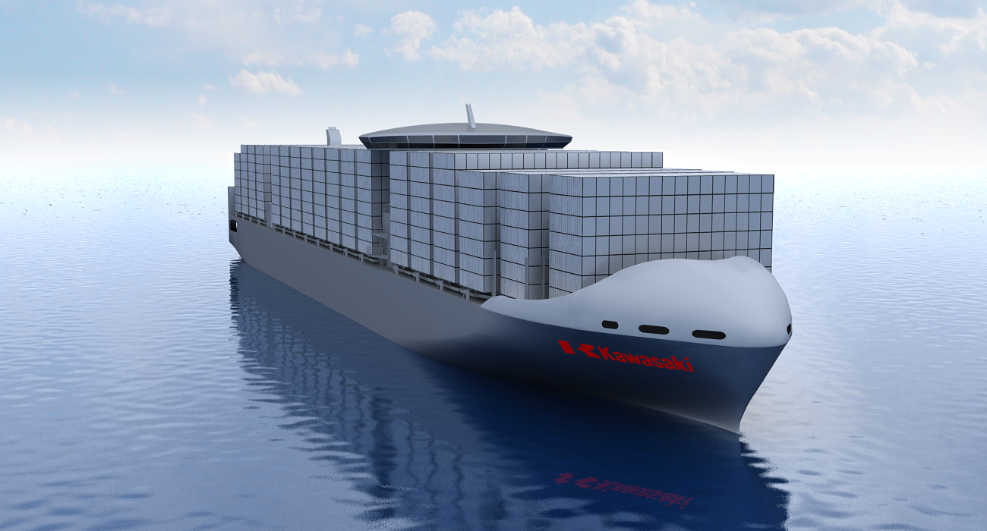
Why Is It Awesome?
Immutability: Servers as Cattle, not Pets
Better Resource Utilization
Declarative vs. Imperative
Self-Healing
Rolling Updates & Rollback
Manual & Automatic Horizontal Scaling

Slide 11
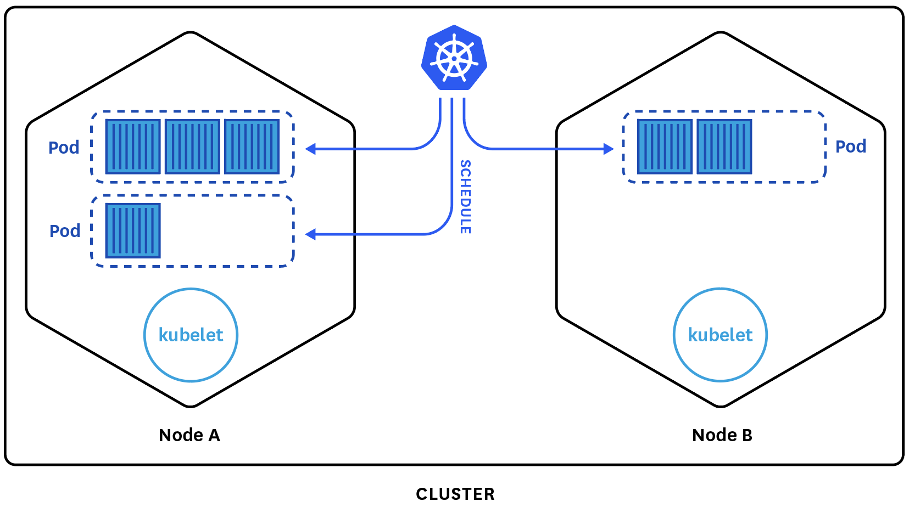
Kubernetes Cluster

Slide 12
Master
Manages & Monitors Nodes
Schedules Pods
Can be made Highly Available
Container Host (Docker)

Slide 13
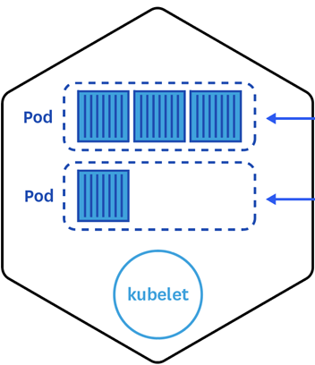
Nodes
Container Host (usually Docker)
Linux or Windows*
Can be Hybrid (!)
Dynamic
Hosts
One Kubelet
One or more Pods

Slide 14

Pods
A Unit of Deployment
One or more Containers
Storage Resources
Network IP Address
Managed by Kubelet

Slide 15
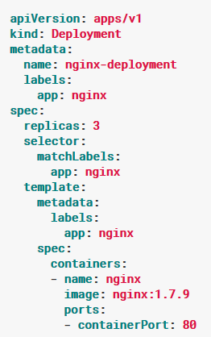
Deployment
Used to Deploy Application
Stored on Master
Defines Desired State
Configure using Manifest File
Can be Modified/Updated
Deployment Manifest for Nginx

Slide 16
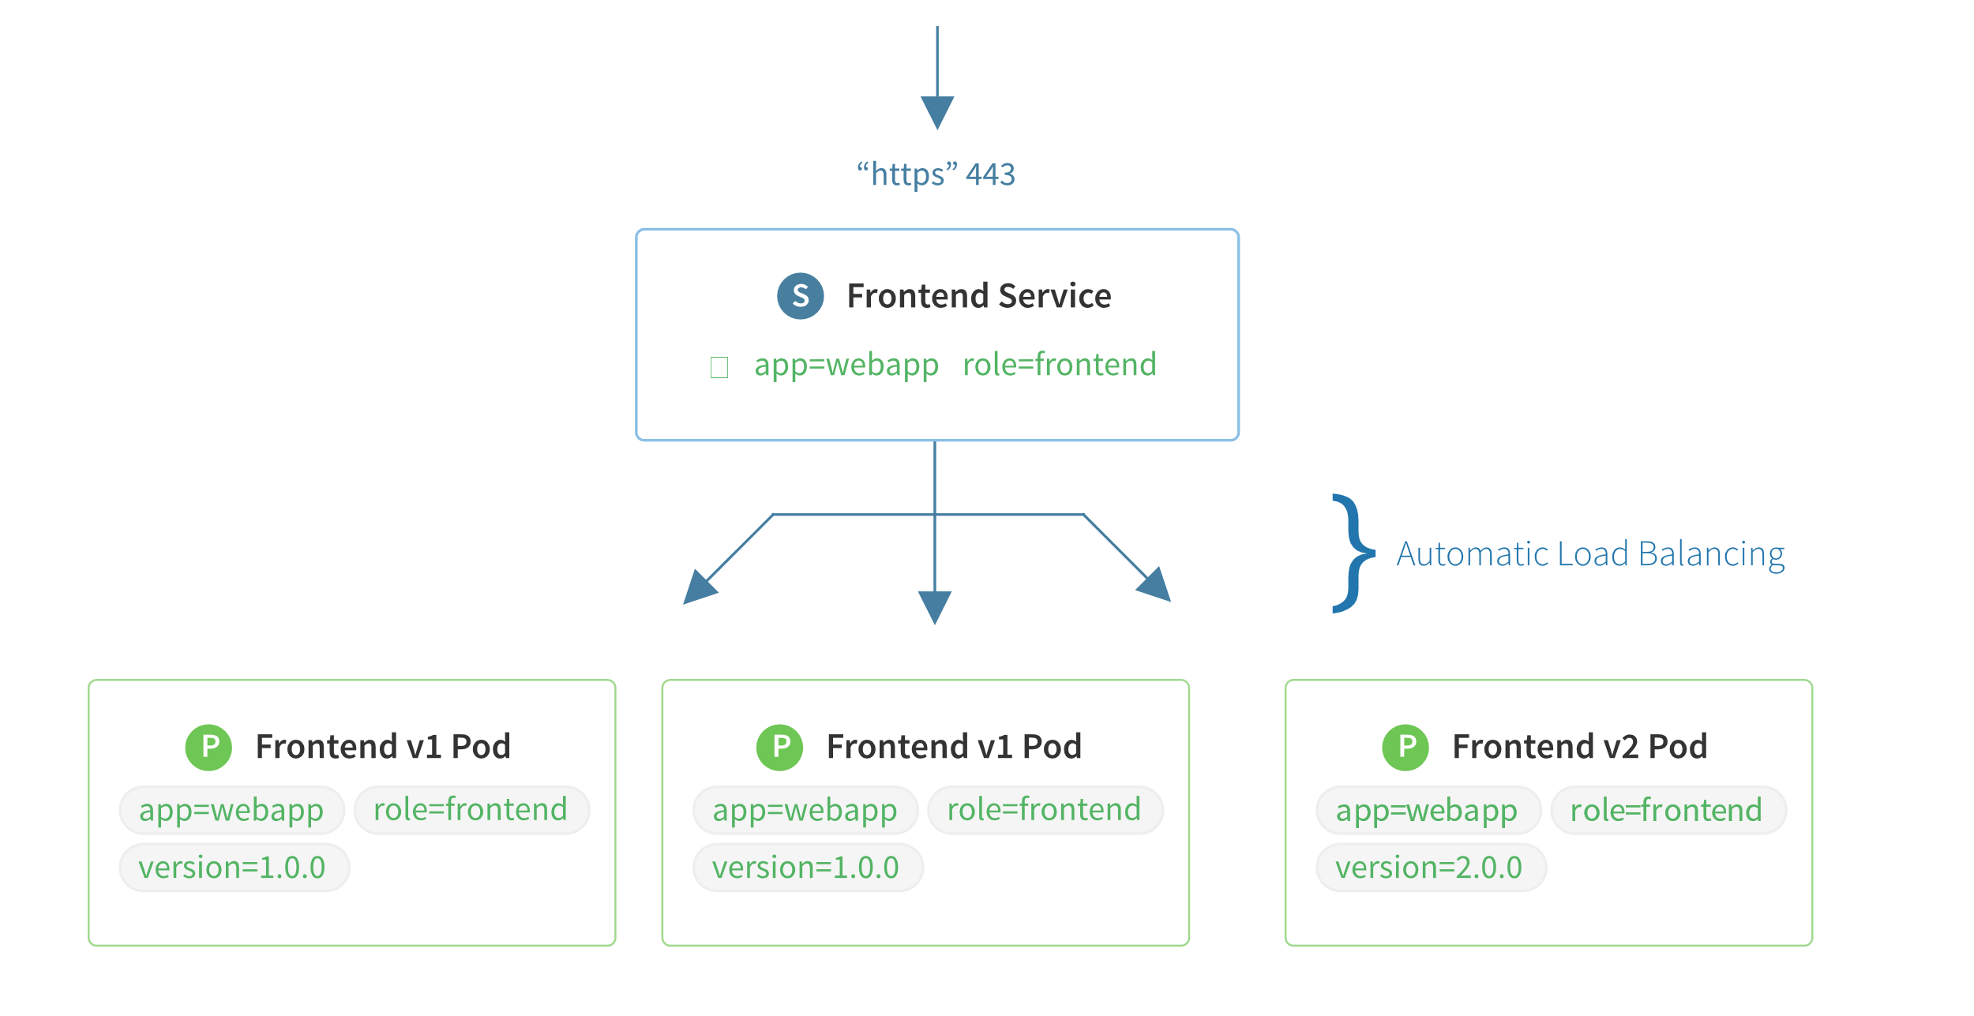
Service
Defines External Access to Pods
Maps Port to Target Port
Abstraction
Labels

Slide 17

Kubectl
Kubernetes CLI
Manages Kubernetes Clusters
Connects to Master
Uses HTTPS REST API
Username + SSH Key
Installed in Azure CloudShell

Slide 18

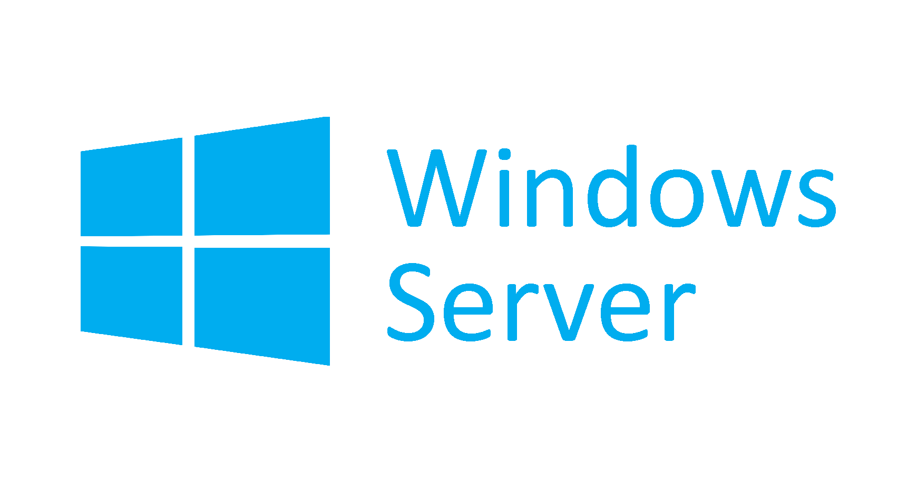
Azure Kubernetes Service (AKS)
Managed Kubernetes Service
Only Pay for Nodes – Master is Free
Linux Containers Supported
Windows Server Containers - Not Yet
On AKS Roadmap
Can be run in Azure Container Instances using Virtual Kubelet

Slide 19
Azure Kubernetes Service cont.
Identity and Security Management
Role-Based Access Control (RBAC) supported
AAD Integration
Cluster Node Scaling
Scale-out via portal or AZ CLI
Autoscaling requires AKS running Kubernetes v1.10 or greater

Slide 20
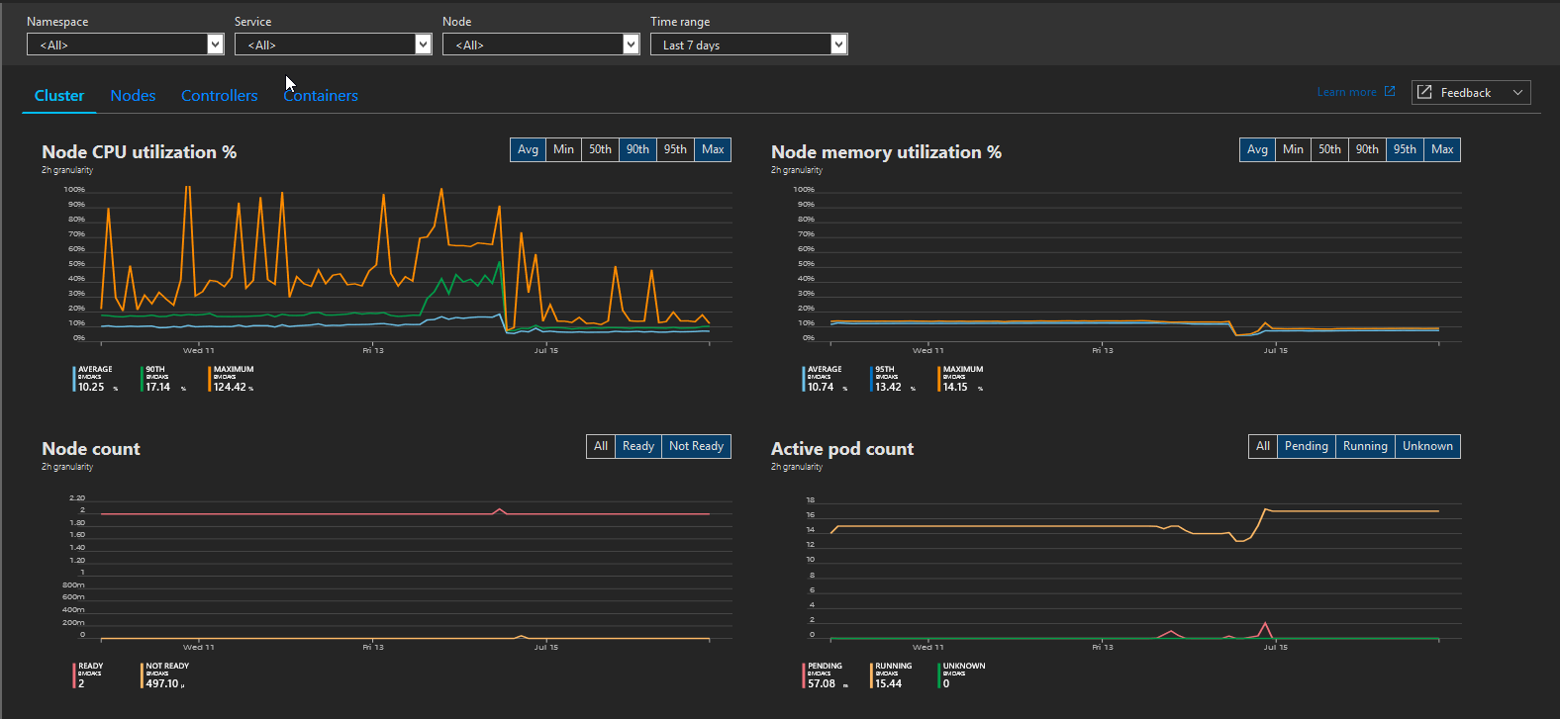
Azure Kubernetes Service cont.
Integrated Logging and Monitoring
Requires Azure Log Analytics Workspace

Slide 21
Azure Kubernetes Service cont.
Cluster Node Upgrade
Easily upgrade Kubernetes version without disruption
Storage Volume Support
Azure Disk and Azure Files automatically provisioned for Containers requiring persistence
HTTP Application Routing
Automatically assign public Azure DNS names to Kubernetes services

Slide 22




Azure Kubernetes Service cont.
Development Tooling Integration
Full Developer and DevOps story with Visual Studio and Visual Studio Code as well as third party IDE
GPU Enabled Nodes
Virtual Network Integration
CNCF certified as Kubernetes conformant

Slide 23
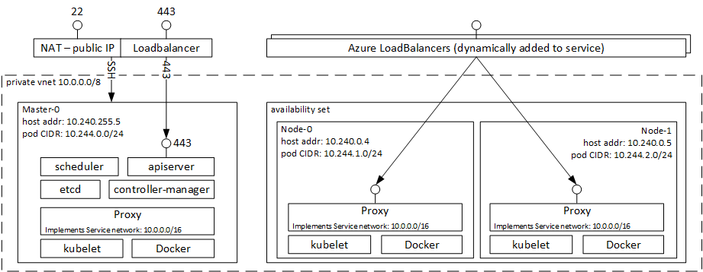
AKS Architecture

Slide 24

Important Notes
Currently Only Supports Linux Nodes
Windows is on the roadmap
Scale-out but not Scale-up
Can’t change node VM size after provisioning
Not usually required though
Additional Resource Group
A second resource group is created when deploying AKS to contain all the cluster resources.

Slide 25


Kubernetes Helm
Deploy & Manage Apps in Kubernetes
Charts contain pre-packaged Kubernetes Resources
Helm manages Kubernetes Charts
Charts Repository Hosted in GitHub

Slide 26
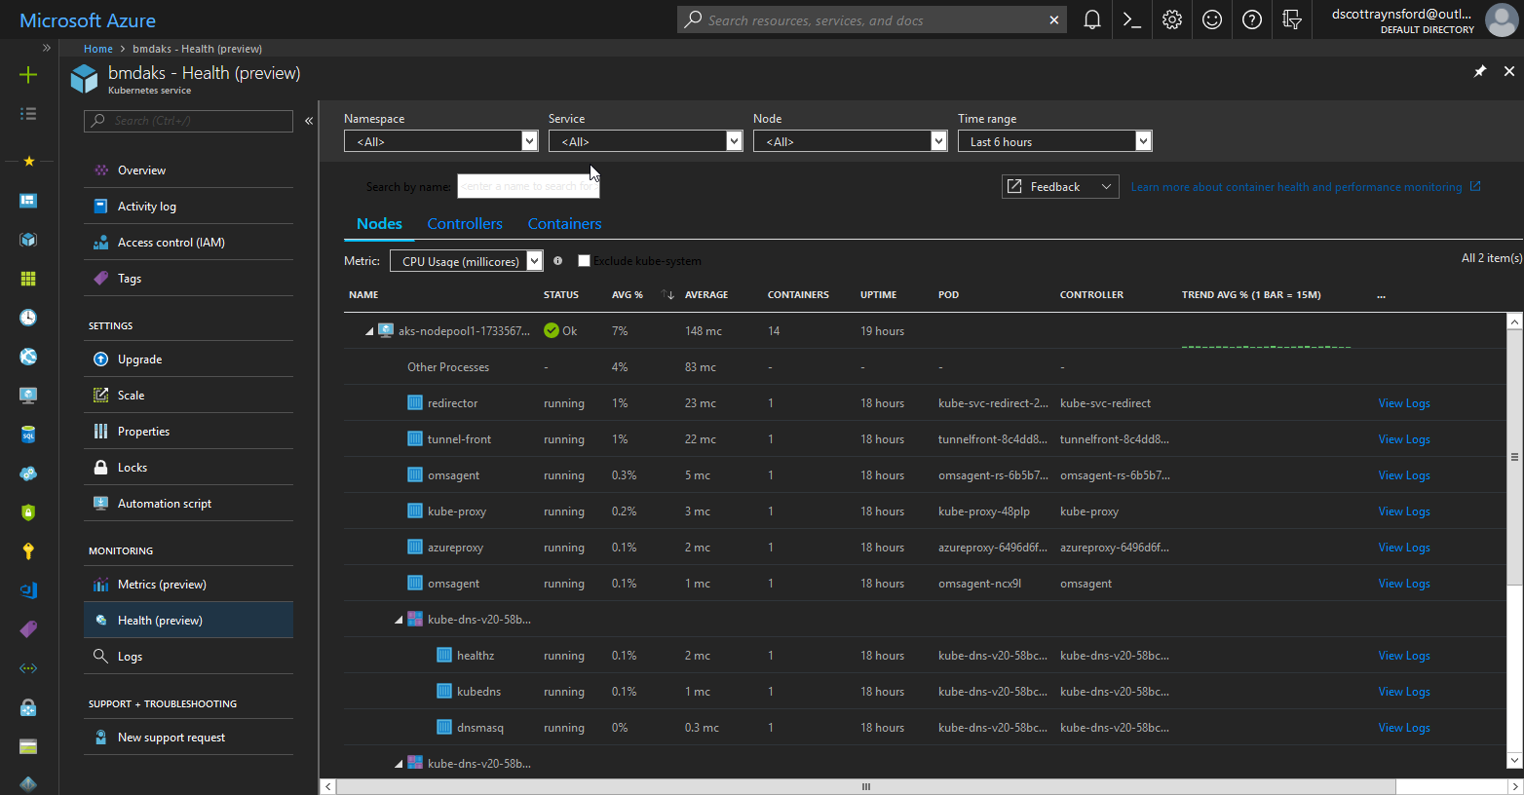
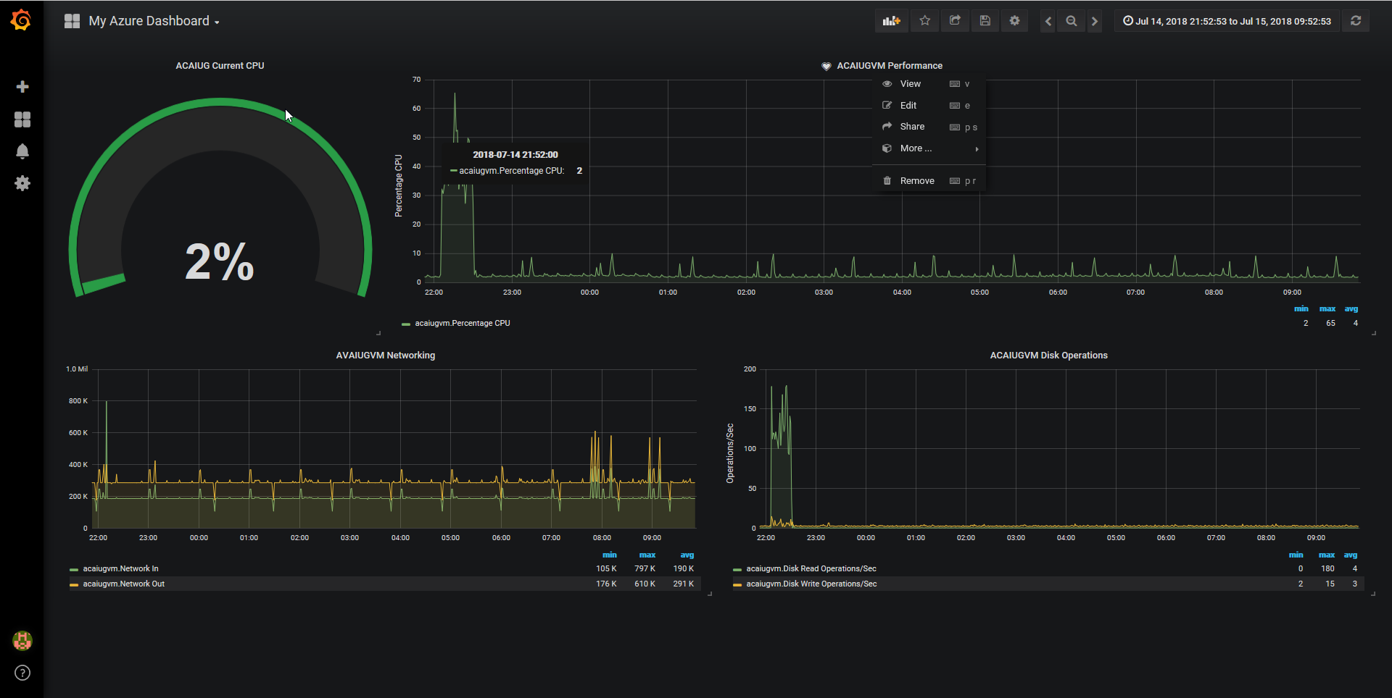
Demo
Create an AKS cluster using Azure Cloud Shell
Manage Cluster using Azure Cloud Shell and kubectl
Enable Helm Tiller on Cluster
Deploy Grafana to AKS using Helm
Create Azure VM Monitoring Dashboard in Grafana
Run the Demo on your own
http://bit.ly/2NdJQ30

Slide 27

Takeaways
AKS:
Managed Kubernetes Service
Only Pay for Nodes
Great way to run:
Modern Workloads
Legacy Workloads
Microservice Workloads
Checkout Azure Dev Spaces
Run the demo yourself:
http://bit.ly/2NdJQ30

Slide 28
THANKYOU!
Any questions?
Twitter: @dscottraynsford
Email: dscottraynsford@outlook.com
Blog: https://dscottraynsford.wordpress.com/

